Slide 1
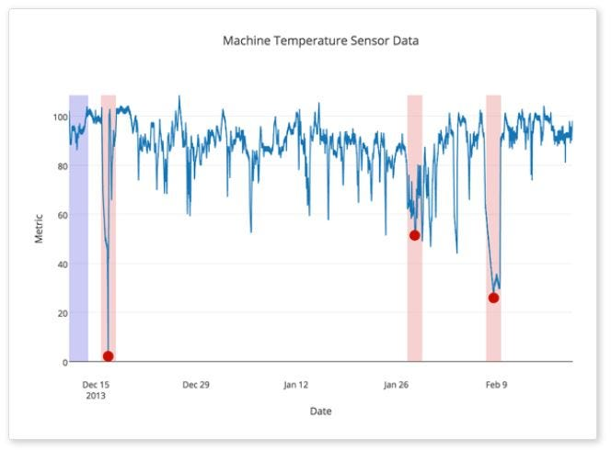

IoT Capstone Project
Report
Temperature IoT Data
Anomaly Detection
(Using ML methods)
Semester: Fall 2023 Armin Attarzadeh & Arshia Goshtasbi
Instructor: Dr. Reza Vahidnia

Slide 2
Applications of Anomaly Detection in IoT Enhancing IoT Security and Efficiency
Industrial Automation:
Early identification of equipment malfunctions or overheating in industrial settings.
Energy Management:
Optimizing energy consumption by identifying anomalies in temperature patterns in smart buildings and facilities.
Healthcare:
Ensuring proper storage conditions for pharmaceuticals and medical supplies.
Agriculture & Food Safety:
Early detection of climate-related anomalies affecting crop growth.
Ensuring the correct storage temperature for perishable goods during transportation and storage.

Slide 3
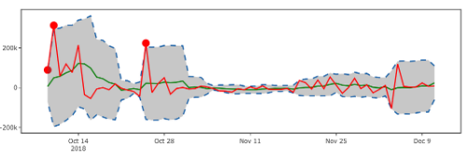


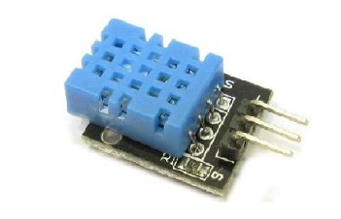
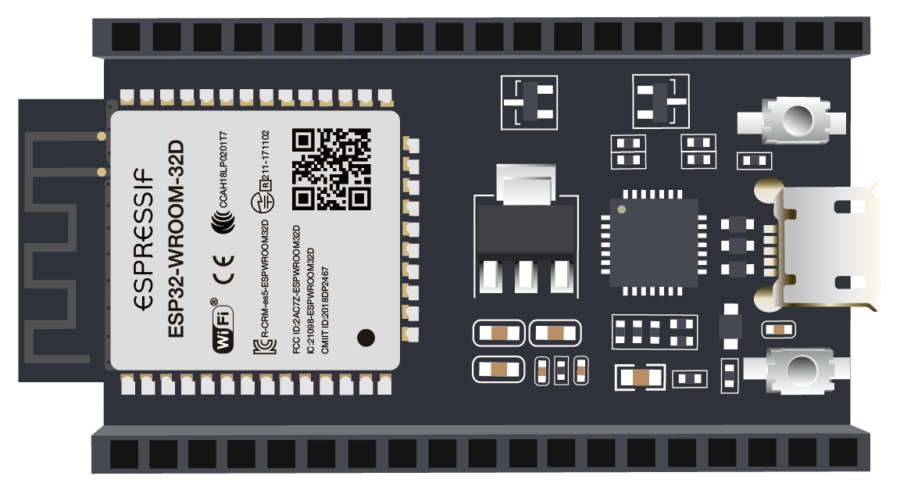


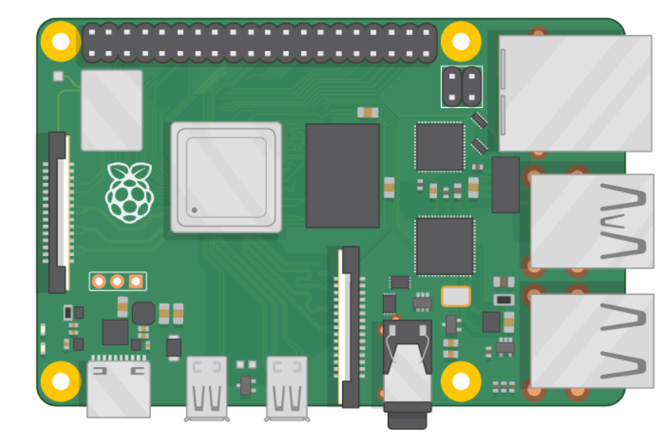

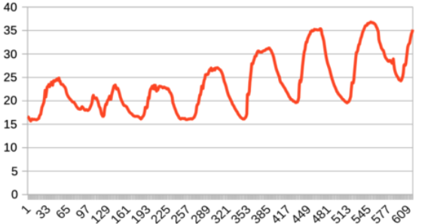
System Diagram Overview of IoT System Components
Real Time
ANAYLSIS
EDGE
ML detection
Cloud DB
RT DASHBOARD
MQTT + Encryption
SECURE Transmission
GETEAWAY RPI 4

Slide 4
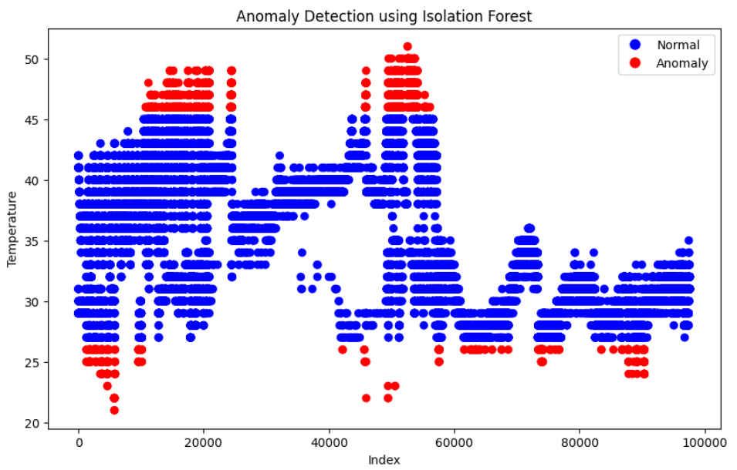
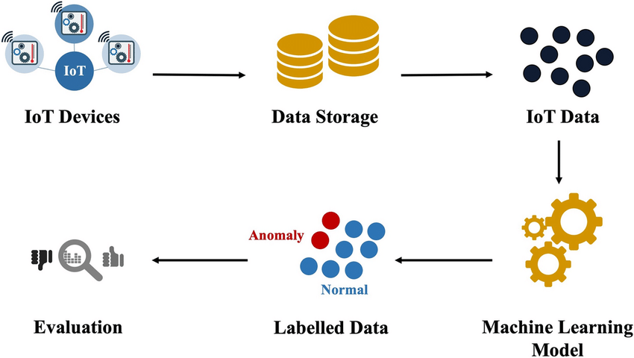
Review: Steps for Implementing Anomaly Detection in IoT From Data Collection to Actionable Insights
e.g. Isolation Forest

Slide 5
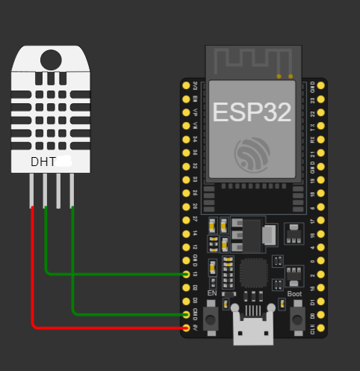
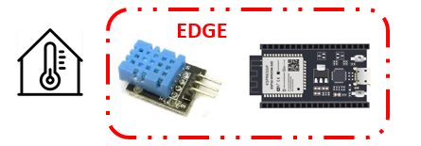
Part 1: (Design / Hardware / Sensors)
Connecting the DHT11 Sensor to ESP32 and Receiving the temperature:
After Installation of the sensor with the following format, the script to show the temp is used.
The Schematics:

Slide 6
Part 2: (Communications)
Sending the received data via Bluetooth to Raspberry pi. (C Code)
Receiving the data via Bluetooth in Raspberry pi. (Python Code)
The bluepy library is used
In the part the root access is required.
Receiving the data via Bluetooth in Raspberry pi, Encrypting the data using RC4 and sending it to cloud using MQTT. (Python Code)
SECURE Transmission

Slide 7
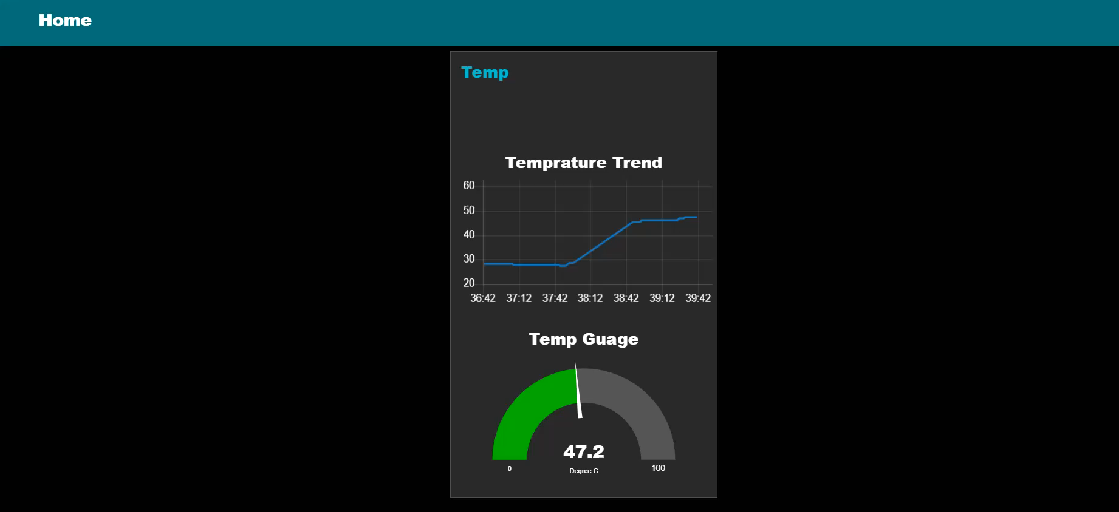
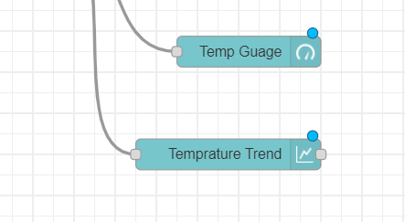

Part 3: Dashboard & Monitoring

Slide 8
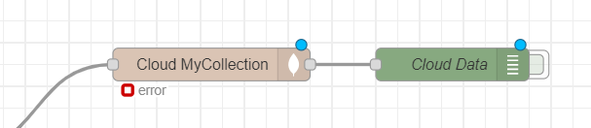

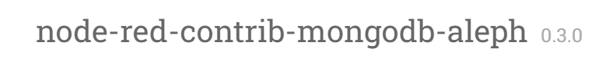
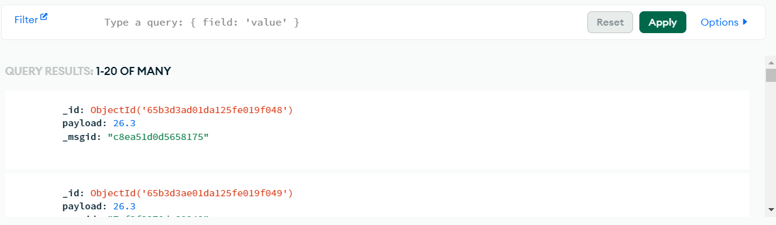
Part 4: Cloud Database

Slide 9

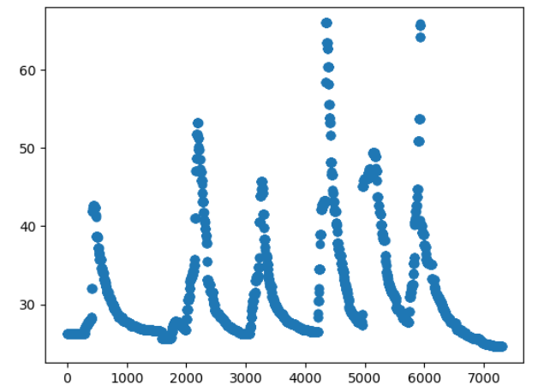

Part 4: Cloud Database
# Retrieve temperature data from MongoDB

Slide 10
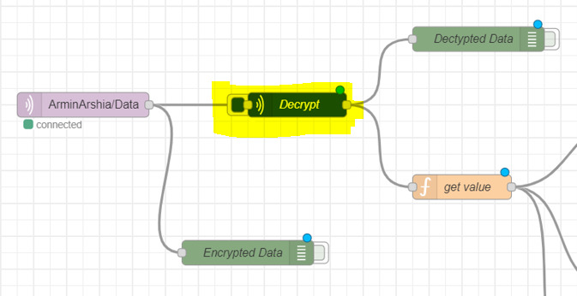
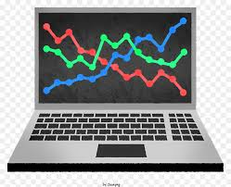
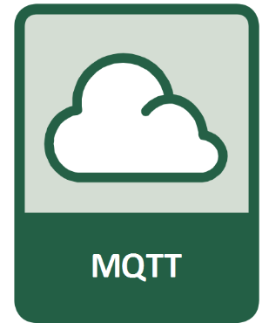
Part 5: Encryption & Decryption
We use RC4 algorithm for Encryption.
Its implementation is easy but useful for security
(Send) Encyption.py --> running on RPI
Data has sent to mqtt borker in secure way
(Receive) Dectyption.py --> running Node-red
RC4 Encryption
/sent: 4daf9b6d4ba702afcc2497
/in: {'temp':35}
/out {'temp':35}
/key: Armin
/key: Armin

Slide 11
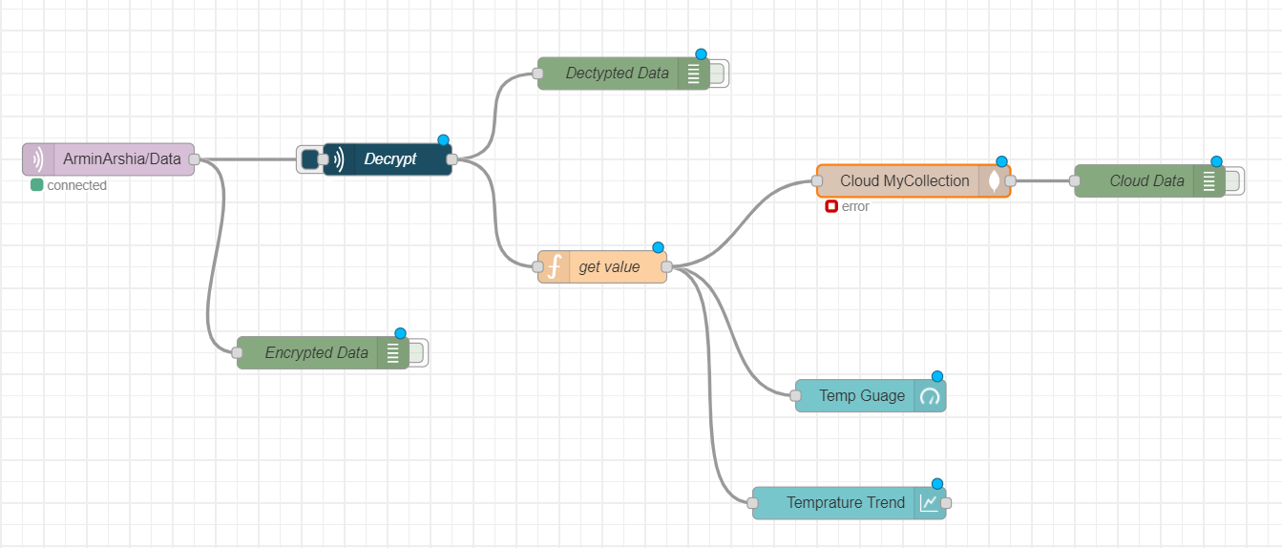

Slide 12
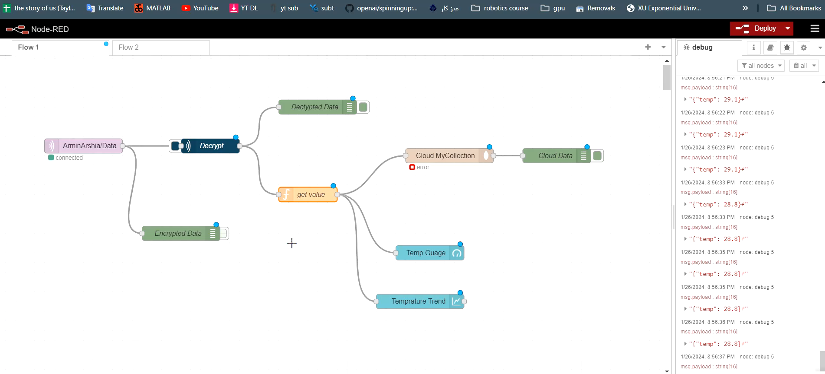

Slide 13
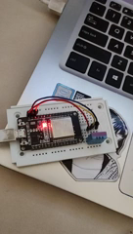

Part 6: (Gateway)
Raspberry pi 4 is used as a gateway.
Tasks:
Collecting the data from ESP32 via Bluetooth
Encrypting the data using RC4
Sending the encrypted data to cloud Via MQTT

Slide 14
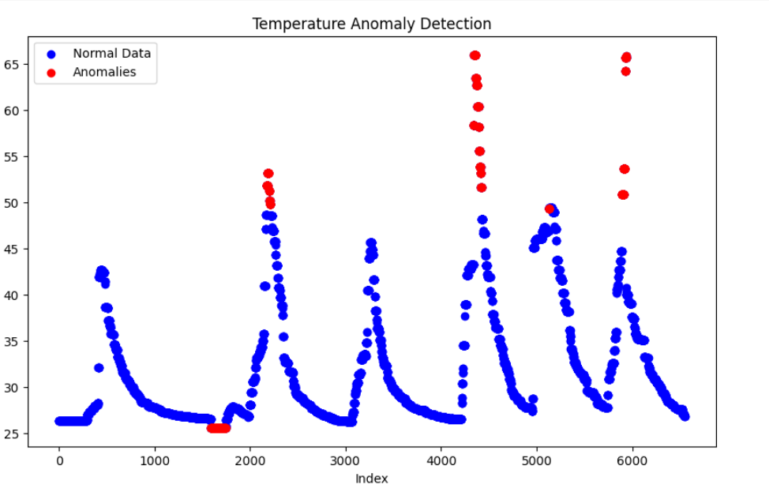
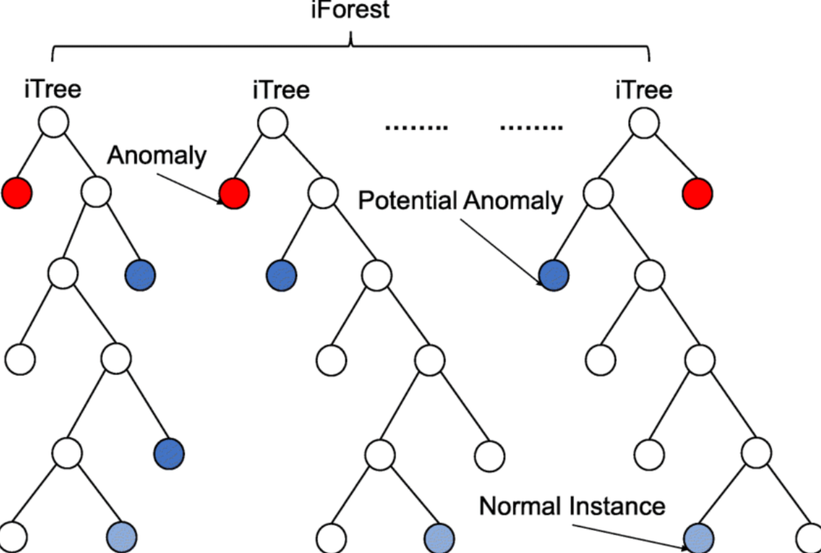
Part 7: ML Anomaly Detection Unsupervised ML Algorithm

Slide 15
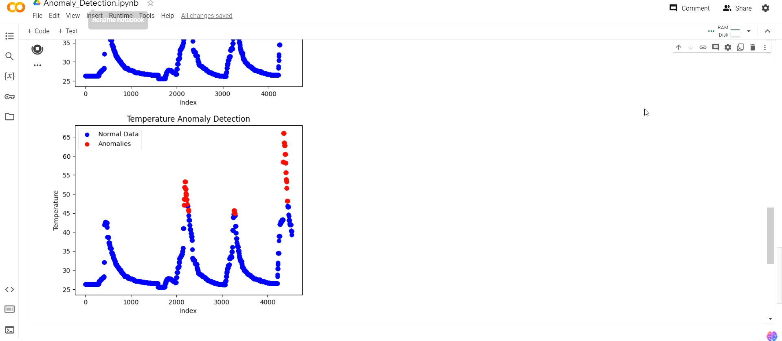
Part 7: ML Anomaly Detection Unsupervised ML Algorithm
while True:
# Read temperature data
temperature_data = read_temperature_data()
# Perform anomaly detection and visualization
perform_anomaly_detection(temperature_data)
# Wait for 10 seconds
time.sleep(10)

Slide 16
Thank you !

